Slide 1
Customer Retention Data
A comprehensive review

Slide 2
Overview
Introduction
Problem Statement
Problem Analysis
Description of Customer Retention
Importance and Benefits of Customer Retention
Data Analysis of the DataSet
Understanding through Visualization
Assumption
Concluding Statement

Slide 3
Overview
An e-commerce company generally has a huge number of customers and runs at the risk of churning to a competitor. Therefore, it was necessary to find out insights as to which customers are at the risk of leaving, why they may leave, and on which customers should the company focus the retention effort on.

Slide 4
Introduction
In today’s world the whole equation of conducting a business has changed. As per Online Business vs Offline Business Statistics, 82% of consumers use online media every day compared to offline media (24%). There we understand that business can see more profitability in an online platform when compared to their physical counterparts. Now this calls for a competition to keep the audiences entertained or rather engaged and convert the leads into profitable ROI.
Infact, customer retention is one of the main relationship marketing objectives. Currently the perception and application of customer retention is significantly valuable for companies. Thus, in order to perceive and apply marketing principles in practice relevantly, it is important to ground theoretically and assess empirically customer retention.
Let’s take into account the details of an e-commerce shopping site to understand how several factors can change the statistics of customer retention.

Slide 5
Problem Statement
Owing to the rate of increase in online purchasing, companies now need to focus on improving customer experience. Here, customers’ satisfaction can be attributed as one of the most important factors to ensure greater customer retention. In this regard, companies need to find out “What individual factors motivate a buyer to purchase online as well as restrain to purchase online?”. We will discuss about this in data analysis part.
The main aim of this project is to explore consumer perceptions of internet-based e-retailing. Customer satisfaction has emerged as one of the most important factors that guarantee the success of online store; it has been posited as a key stimulant of purchase, repurchase intentions and customer loyalty. A comprehensive review of the literature, theories and models have been carried out to propose the models for customer activation and customer retention.

Slide 6
Utilitarian value: Utilitarian value is an objective value which provides some functional benefits to the consumers and helps consumers to accomplish practical tasks.
Hedonistic value: Hedonistic value is subjective (Psychological) value which provides an experiential satisfaction. In other words, the immediate psychological gratification that comes from experiencing some activity or from consumption of a product

Slide 7
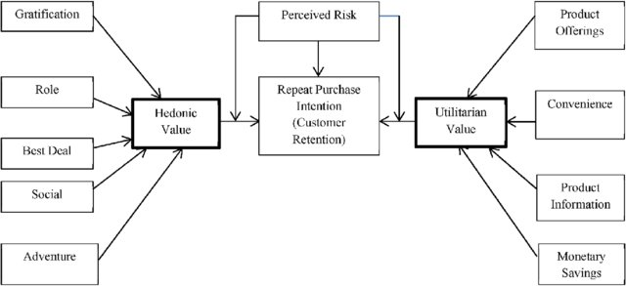

Slide 8
Problem Analysis
The problem statement shows how customers form expectations on technology based self-service quality and suggested five main attributes of ecommerce store quality, that are service quality, system quality, information quality, trust and net benefit.
Many businesses focus on customer loyalty programs to remain competitive in today's marketplaces and explore innovative ways to keep their existing customers engaged. Customer retention is a simple concept. Yet, it often requires effort from every department to improve the customer experience and build lasting trust. So, what is customer retention and why it is so important. Let’s know about it by analysing the problem.

Slide 9
Understanding Customer Retention
Customer retention is a metric that measures customer loyalty, or the ability for an organization to keep its customers over time. In addition to identifying the number of loyal customers, customer retention can reflect or predict customer satisfaction, repurchase behaviour, customer engagement and emotional ties to a brand.
While customer relationships typically begin with an initial interaction, customer retention metrics are related to the first purchase made by a customer and include all subsequent interactions. Once customer retention is measured, organizations can use this feedback to perform data analysis on components of customer experience and customer success. For example, if a drop in customer retention is reported, an organization can use this to help identify the root cause and adjust its product offerings.

Slide 10
Why is customer retention important for businesses?
If an organization does not focus on customer retention but instead focuses solely on expanding its customer base, it is potentially losing out on repeat customers. While the process of gaining new customers, or customer acquisition, is important, it is also much more expensive. Maintaining customers and transitioning them into recurring customers is just as important of a process as gaining new ones.
How to measure customer retention and key metrics?
Customer retention is typically measured in terms of retention rate and should be monitored continuously. The first step to determining this rate is to identify the period of time an organization wants to record. This can range from a month to a fiscal year or beyond. Other factors used to determine the retention rate include the following:
the number of customers in the customer base at the start of the period (S);
the number of customers at the end (E); and
the number of new customers acquired over time (N).
These metrics should be recorded. Once retrieved, the formula is applied as follows:
E-N/S x 100 = retention rate

Slide 11
Importance of Customer Retention
Customer retention measures not only how successful a company is at acquiring new customers but also how successful they are at satisfying existing customers. It also increases ROI, boosts loyalty, and brings in new customers.
It's also easier and more cost-effective to retain customers than to acquire new ones, returning customers spend more and buy more often, and refer friends and family. Only a 5% increase in customer retention can increase company revenue by 25-95%.
The numbers don't lie: Retaining customers brings companies a ton of ROI.
There are a few reasons why customer retention is critical to company growth and success:
Affordability: It's 6 to 7 times more expensive to acquire a new customer than it is to retain an existing customer.
ROI: A 5% increase in customer retention can increase company revenue by 25-95%.
Loyalty: Retained customers buy more often and spend more than newer customers. They've learned the value of a product or service and keep coming back, again and again.
Referrals: Satisfied, loyal customers are more likely to sing a company's praises and refer their friends and family — bringing in new customers, free of charge.
It might seem obvious — of course, companies should want to retain customers — but when companies start growing quickly and struggle to implement a solid customer support program, proactive customer support for existing customers can slip through the cracks.

Slide 12
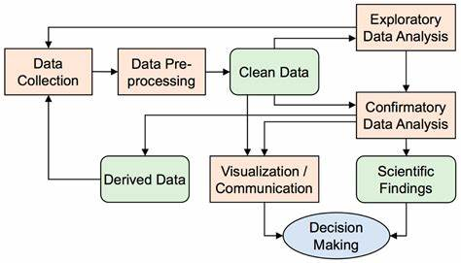
Data Analysis of the Data-Set

Slide 13
Exploratory Data Analysis
I have imported the dataset which was in excel format.
Performed some of the statistical analysis like dimension of the dataset, data types, info, number of unique values, value counts etc.
The column names in the dataset were not in the proper format so, I have renamed them for better understanding.

Slide 14
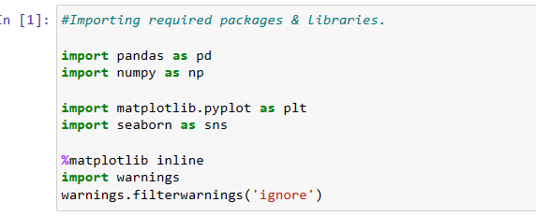
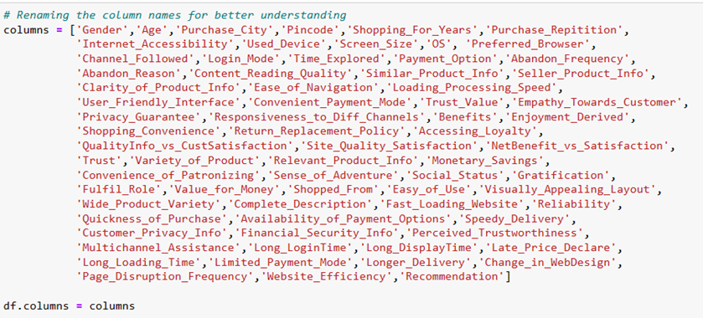
Data Pre-processing:
Firstly, I have imported the necessary libraries and dataset.
Checked the dimension of the dataset, data types of the features.
Checked the information of the data frame using info() and checked the number of unique values present in the dataset.
Since the columns had no proper names, so I renamed them with new name as below.
I have checked the null values and found no null values present in the dataset.
Checked the value count of each column. By checking value count function, I found some of the columns contains duplicate and unwanted entries, so I have replaced them using appropriate values.
Visualized each feature using seaborn and matplotlib libraries by plotting count plot, pie plot, distribution plot, box plot and factor plot.
Performed label encoding.
Checked the skewness and outliers. Since all the columns are categorical, so I haven’t removed skewness and outliers.
Checked the correlation between the features and visualised it using heat map.
Described the data using describe().

Slide 15
Data Visualizations
I have performed both univariate and bivariate analysis to visualize the data. In univariate analysis I have used pie plots, count plots and distribution plot and in bivariate analysis I have used count plot, factor plot and boxplots. Here I will be showing only bivariate analysis plots to analyse the data.

Slide 16
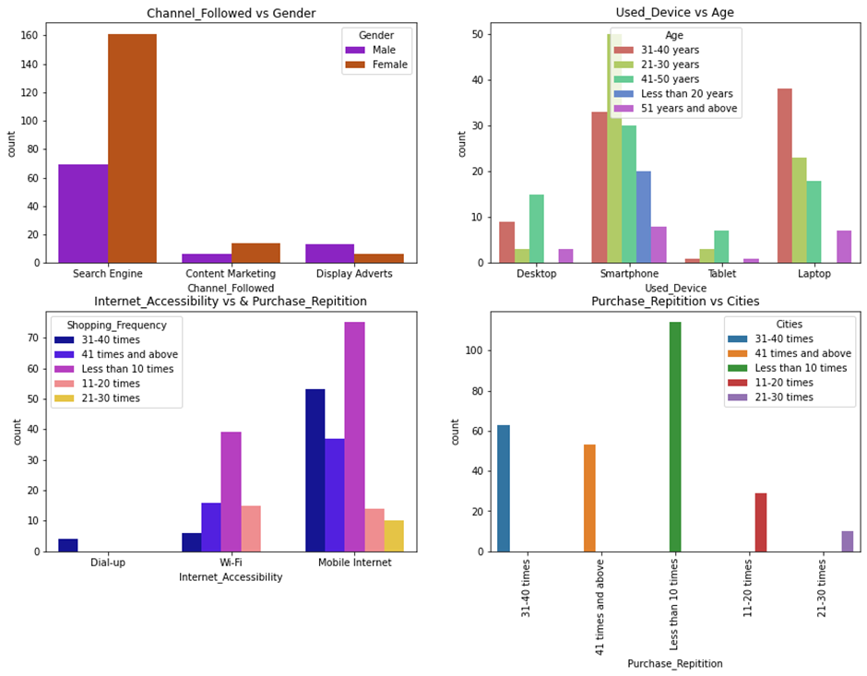
Observation:
• We can see that most respondents are female who shopped online for 4 or more years and the count is also high for the females who shopped from 2-3 years. There are only a few male customers who have shopped online more than 4 years.
• Many customers’ falls within the age range 31-40 years and 21-30 years, use Smartphones followed by Laptops to access the online shopping websites.
• Most of the customers access the shopping websites more than 31-40 times in 1 year through Mobile Internet to shop the products. Only few of the customers used WIFI network to access the shopping store.
• Most of the customers used ecommerce websites less than 10 times in a year from the city Delhi to shop the products.

Slide 17
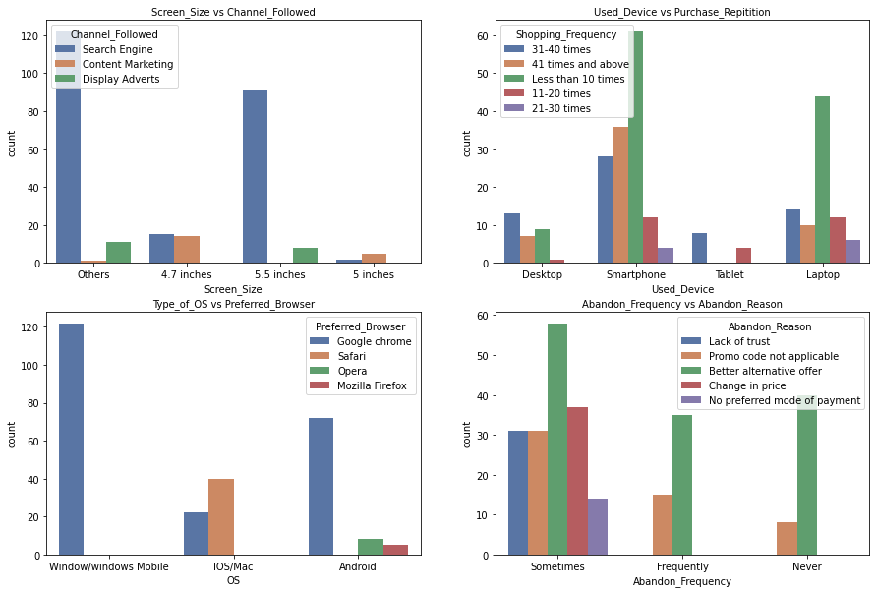
Observations:
• The customers having their mobile screen size other than 5.5 inches(others), 5.5 inches have chosen search engine to reach their preferred online store for the first time.
• Most of the customers used Smartphones 31-40 times to access the shopping site. Many of them also have windows OS and use Google chrome to access the shopping sites. Few of them use IOS/Mac to launch Google chrome or Safari and open the online shopping store.
• Most customers abandon the website due to lack of trust. Others abandoned because the promo code was not applicable.
• Thus, shopping sites should pay more importance to offering discounts and applicable promo codes to retain the customers.

Slide 18
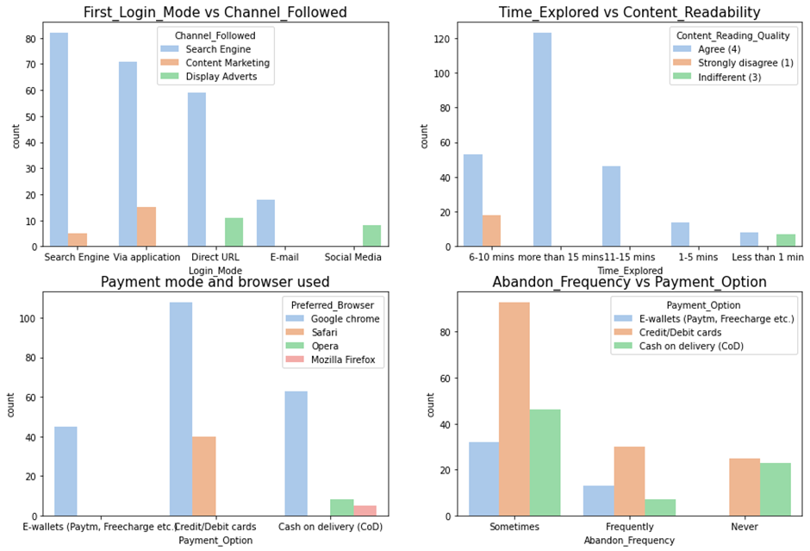
Observations:
• Most people used Search engine to arrive to their favourite store for the first time and thereafter.
• Most preferred/agreed that the content should be easy to read and understand. They explored more than 15 mins before making a purchase decision. Some were quick and decided within 6-10 mins. It means that clearer and relevant information can help improve purchases on a shopping site.
• Google chrome seemed to be the most preferred browser to reach the websites. Payments were done mainly via Credit/Debit cards.
• Some customers agreed that they sometimes abandoned their selected items left without making payments and most of them making the payment using Credit/Debit cards, followed by Cash on delivery.

Slide 19
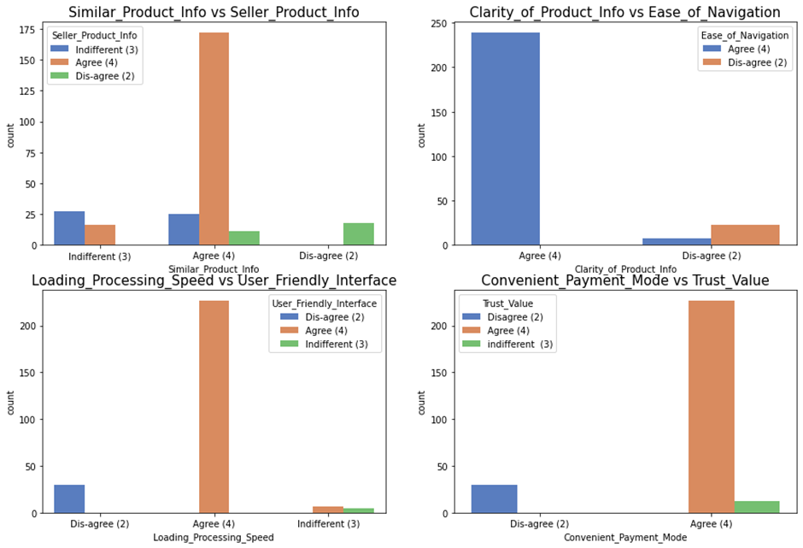
Observations:
• Customers look forward to information on similar product, complete information on listed seller and product on offer to make a purchase decision. Thus, online shopping sites must give complete information about the product and seller.
• Almost 90% agreed that the website or app should be easy to navigate with all information.
• Most want faster processing speed alongwith user friendly interface. Slow sites tend to frustrate customers and in turn increase bounce rates.
• Most of the customers feel trust is important while purchasing on an online retail store. This also gives an idea how the company fulfils its transaction at the stipulated with convenient payment modes.

Slide 20
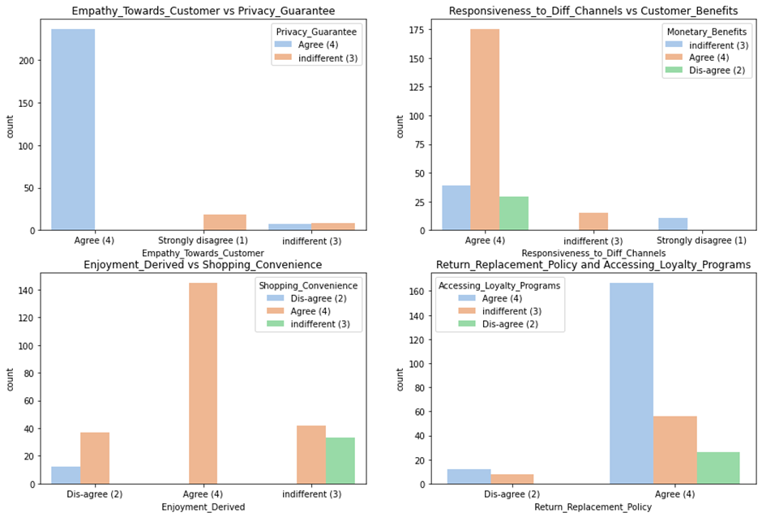
Observations:
Most customers agreed that companies should have empathy towards customers and also ensure privacy guarantee. This will make sure all their queries are resolved and their credentials remain safe and secure.
Customers also love the fact that online shopping offers monetary benefits (through offers, discounts, cashbacks, etc.). Here responsiveness through different channels is important as this gives the customers to reach out to the company in case of difficulties with a purchase.
Most of the customers believed that they enjoy online shopping as it is convenient and flexible. These people con tribute to the increased sales as these people enjoy shopping for satisfaction and not necessity.
Another important factor is the return and replacement policy of the shopping site. Customers are willing to return to companies which has good return or replacement policies and offers good loyalty programs. This helps in customer retention to a great extent.

Slide 21
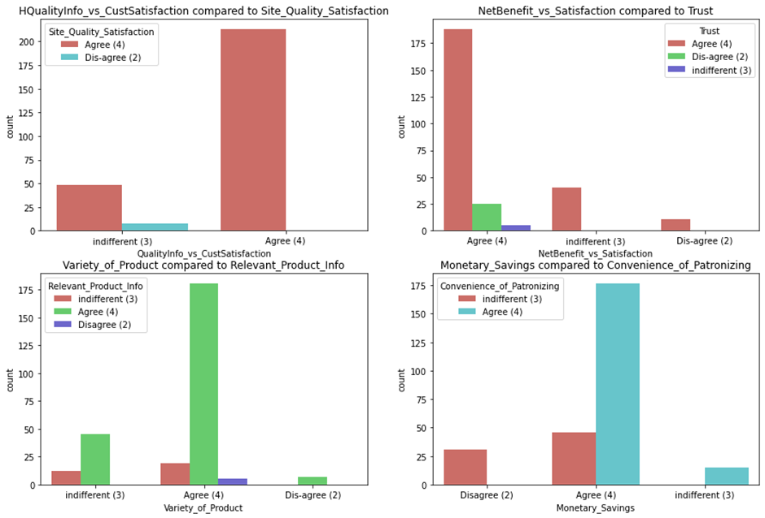
Observations:
Quality information is a key factor that enhances satisfaction. Thus, customers tend to rely on quality information. E-stores should focus on services that makes their customers happy and satisfied.
Net Benefit (as coins/points) is another way to enhance the satisfaction of customers. This should be cultivated along with values of trust. More benefits to the customers means the customer will come back for more purchases. And more purchases means more sales and more business.
The wider the range of products the greater choices will the customer have. So, if a company can offer several types of products in different category. Here product relevance, marketing trends and accurate, information can all contribute to higher number of purchases.
If the company can offer money saving offers, it will be an added bonanza. Companies need to make their customers feel that every purchase on the site helps them save money compared to other sites. Thus, this would generate a factor of faith, trust and in turn increase the statistics of customer retention. A factor of convenience can add to the effect even more.

Slide 22
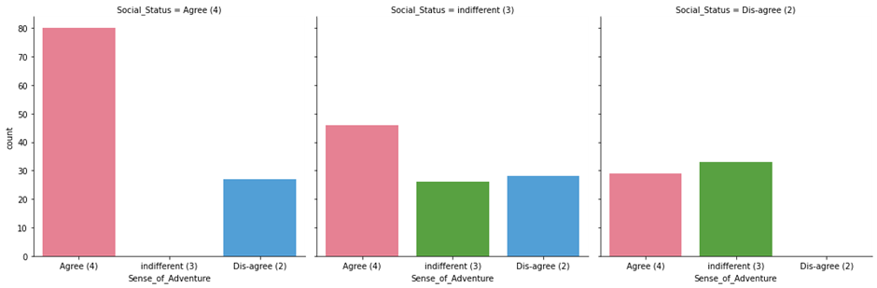
Observation:
Most of the customers agreed that online shopping rises a sense of adventure. Some also agreed that shopping on preferred e-store enhances the social status of the customers. For many it is an adventurous experience and fun to kill their empty time.

Slide 23
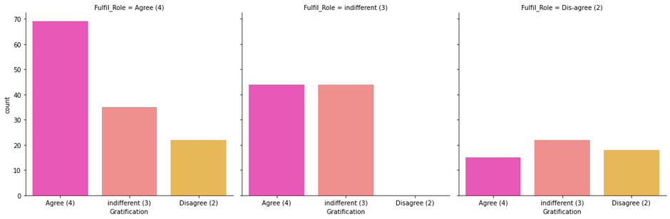
Observation:
If the shopping store is able to tend to customer needs, turn their dissatisfaction into satisfaction and compensate for mistakes, there are greater chances that customers will feel gratified.
Most of the customers have agreed that shopping online has helped them in a way or the other to fulfil certain roles. This step is a culmination of order accuracy, timely delivery, etc. This indicates that satisfaction of the customers is directly proportional to customer's belief of the probability of a service, previous experience. The position vibration can make them seek the company for future purchases.

Slide 24
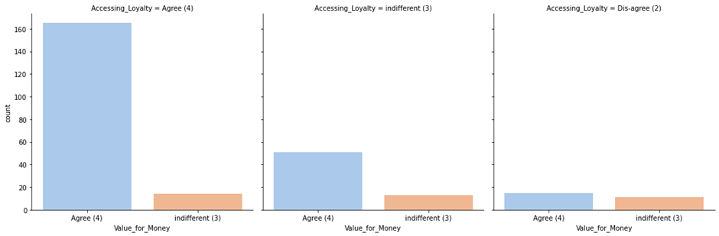
Observation:
The online sites should take efforts to make the customers feel satisfied with the product they purchased online. Thus, they will remark it as a Value for money purchase. Thus, there should be complete and relevant information about product quality.

Slide 25
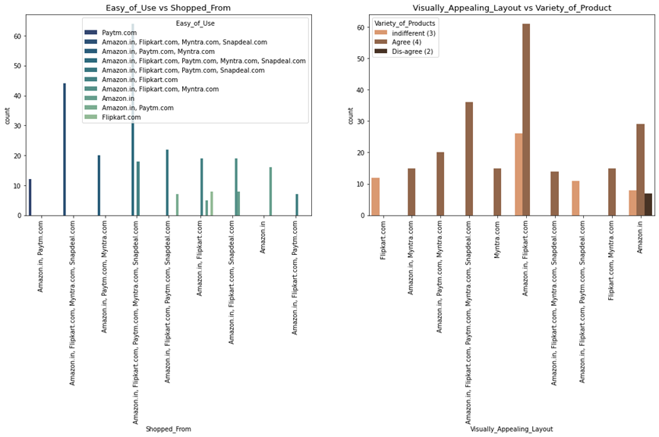
Observations:
There are many online market players. Big names are Amazon.in, Flipkart.com, Paytm.com, Myntra.com, Snapdeal.com. These are easy to use and shop and hence more popular among customers. Additionally, these sites offer huge discounts, great offers, and has a stock of similar and different types of products in almost all categories.
Visually Amazon and Flipkart stand out in their appeal to customers. Thus, it attracts more audiences who are ready to explore the site. Moreover, interesting brand marketing, advertising, etc. often turn the audiences into potential customers.

Slide 26
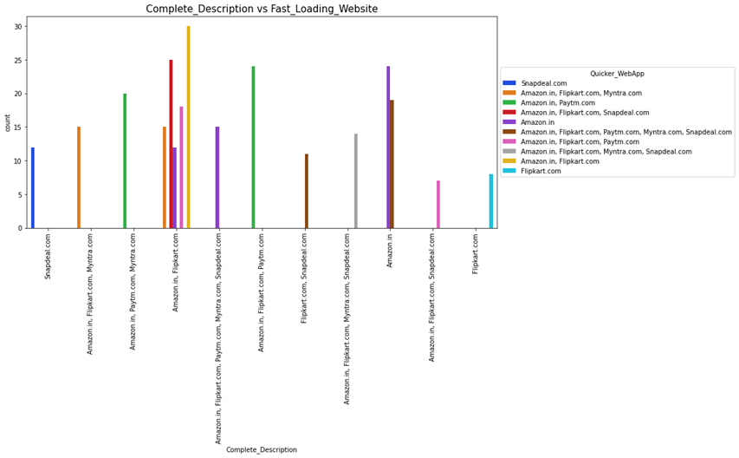
Observation:
A fast loading site/app has a higher chance of customer retention than the one that takes a while to load a complete info/page. Complete description of products, seller, etc. alongwith a fast loading site leaves behind a good impression on the customers. Customers agreed that Amazon and Flipkart offers them good experience when it comes to both complete product description and page loading. These sites face lesser server related issues.

Slide 27
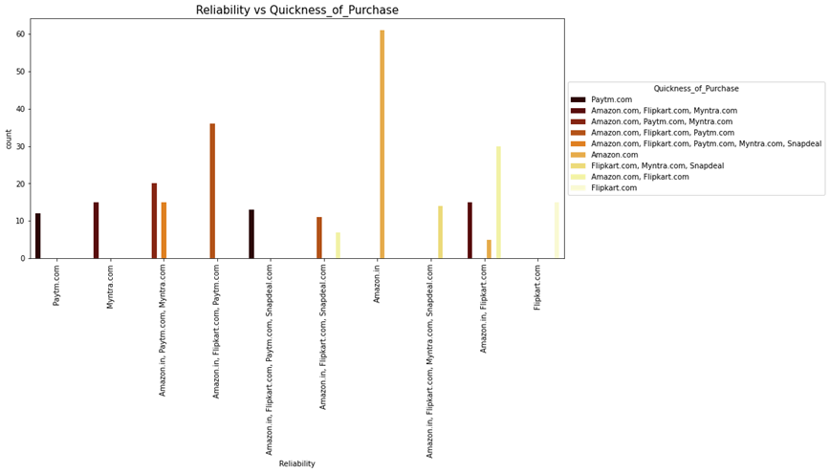
Observation:
Customers feel that Amazon is more reliable and they choose to complete their purchases on Amazon faster than any other site. The reliability factor is transmitted by the shop through different factors like order accuracy, timely delivery, return and replacement, customer assistances, etc. Customers tend to complete their orders faster if there is a timebound discount offer, free delivery, less price, etc.

Slide 28
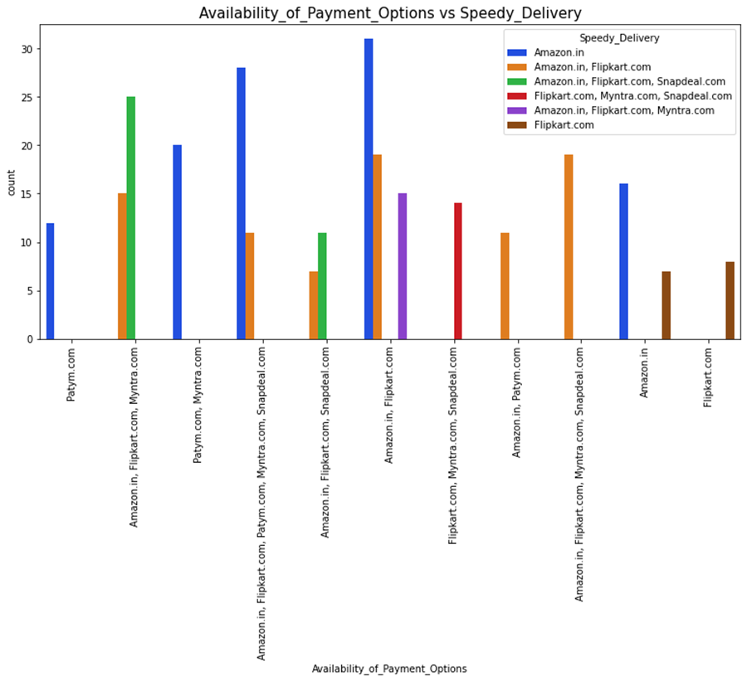
Observation:
We can see that Amazon offers speedy delivery. The site also has different types of payment options that gives the customers their free will to make a purchase of their choice. Here the second most preferred e-store is Flipkart.

Slide 29
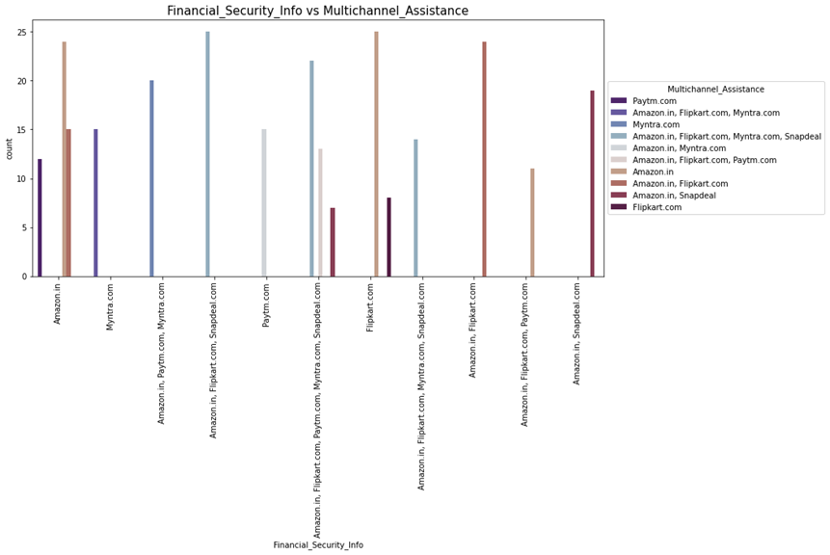
Observation:
Customers have faith that Amazon and Flipkart maintains privacy of their financial information. Also Amazon has multi-channel online presence which attracts customers much more than any other stores.

Slide 30
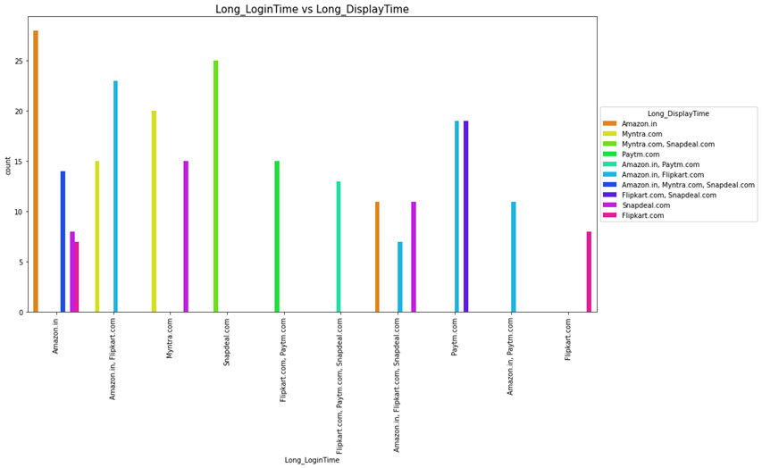
Observation:
Amazon seems to be again on top for its promotions and sales periods in some days. During this time the site will take more time to display the pictures and graphics than usual and also greater time to login. Myntra and Snapdeal also follows a similar approach on days of promotion or sales period.

Slide 31
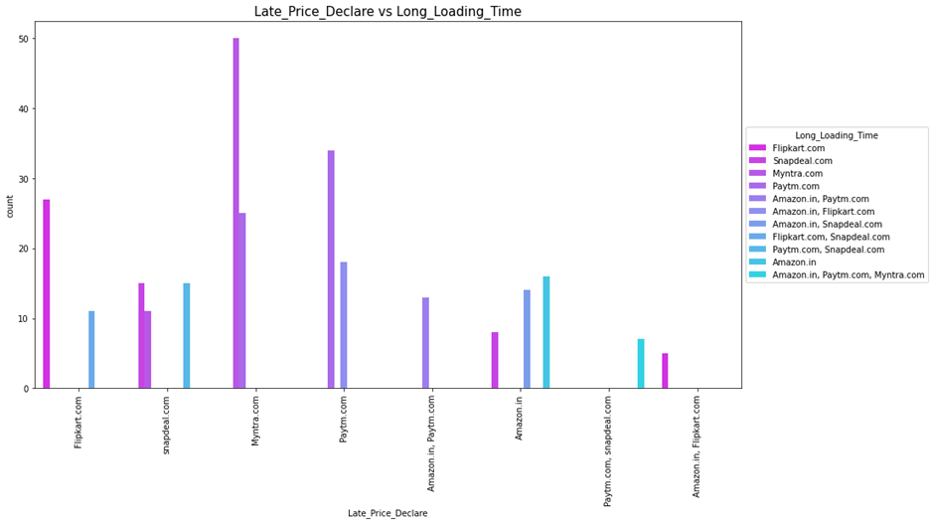
Observation:
We can see that at times of promotion and sales, Myntra takes longer to load and has late declaration of price as several customers tries to shop on the site. The sales and promotions are done in order to clear the sales. The prices are fixed after comparing with the other sites. Also certain benefits might be offered to customers.

Slide 32
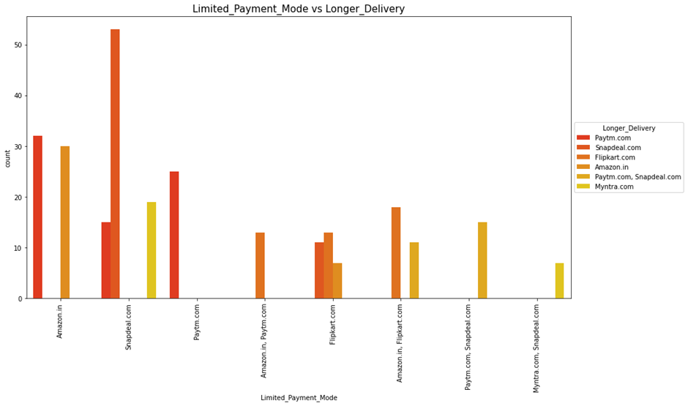
Observation:
We can see Snapdeal has limited mode of payment followed by Amazon. On the other hand, Paytm requires a longer delivery period than others. A customer is mostly willing to choose a company which offers quick delivery rather than a slow one.

Slide 33
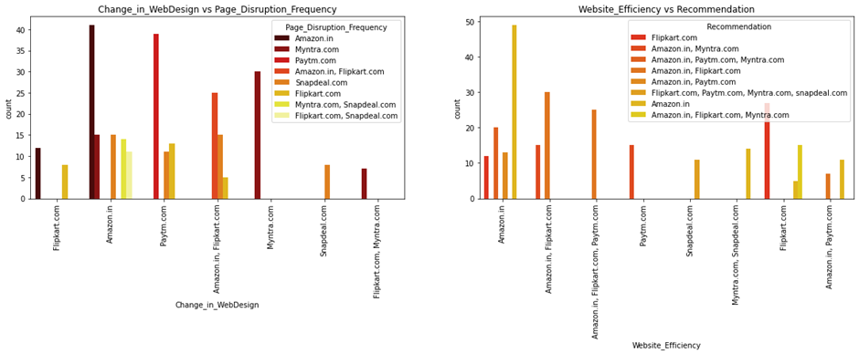
Observation:
We can see that Amazon changes its web/app designs very frequently so that it can attract customers. The site also gets updated everyday in order to stay in trend and meet customer needs. However, it has a longer moving time while moving from one page and sometimes it may shutdown too.
We also see Amazon is more efficient. One would easily recommend Amazon followed by Flipkart as the best Indian online retailer store for purchasing all types of products, as these sites offer great benefits.

Slide 34
Interpretation of the Results:
The results that were interpreted from the visualization are as follows:
The survey reveals that most customers agreed with certain things like ecommerce website should have empathy towards the customers, the website content must be easy to read and understand, similar products should be highlighted for product comparison, payment should be convenient, trustworthy and they feel gratified while shopping etc.
The respondents were asked to give ratings and feedback regarding certain statements that may be used to describe their ideal online store. We have found answers from customers like which websites among listed sites they are familiar with, they find easy to use, reliable, secured, about their delivery, change in web design, etc.
We have that most respondents found Amazon.in as the most used and favourite website followed by Flipkart, Snapdeal.com and Paytm.com.

Slide 35
Findings of the Data Analysis
Quality of ecommerce sites and the factors leading to activation and retention.
How ecommerce websites affect customer satisfaction, customer trust, and customer behaviour, i.e., repurchase intention, customer loyalty, and site revisit.
The factors like product information, convenient payment modes, Trust, Role Fulfilment, change in website design, security/privacy, etc. which throw a positive impact on the ecommerce sites. There were several other factors that did not seem to impact the site which the companies can work to their benefit like ease of navigation, loading and processing speed, longer delivery period, etc.
4. Customer satisfaction and customer trust were found the most important factors
5. The mains reasons that attract customers to shop online and the obstacles which discourage consumers from shopping online.

Slide 36
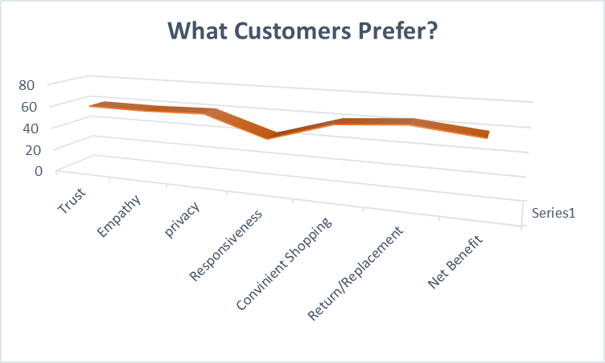
Customers are keen to make purchases from an e-store only if the above factors are satisfied.

Slide 37
Conclusions
Through this project I was able to understand the factors that makes an online shopping site successful.
The data revealed that customers rely on a number of factors when it comes to purchasing online. Some of the important factors as per our analysis is complete and correct information, net benefit, time saving, ease of navigation, security and privacy.
We also found that Amazon is perhaps the most favourite website or app for most customers as it offers lucrative discounts, remains in trend with regular updates, offers utmost data security and privacy when it comes to satisfying its customers. They feel a sense of trust when shopping with Amazon. Moreover, with wide variety of products, multi-channel assistance and multiple payment modes the site is popular among most people. Hence, without any doubt we can say that it has better customer retention and activation.
Therefore, we may conclude that for customer retention and activation businesses should focus their efforts on building trust, ensure empathy towards it customers, offer utmost privacy and security, cater to customer needs and offer multi-channel assistance, so, that customers feel gratified and tend to return to the site/app for their quality services.

Slide 38


